Slide 1
CDW-G SEWP Ordering Guide POP 5/1/2015 – 4/30/2026
Contract Numbers NNG15SC04B & NNG15SC28B

Slide 2

About SEWP
SEWP V is a multi-award Government-Wide Acquisition Contract (GWAC)
  Visit https://www.sewp.nasa.gov/about_us.shtml to learn more about SEWP!
Contractors are provided fair opportunity at the individual order level as appropriate per FAR Part 16.505(b), including the SEWP RFQ tools.
SEWP is a Best in Class (BIC) Contract.
  Within this document CDW-G has provided Policy and procedural information regarding installation, basic warranty, extended warranty, technical support, software support, and other post delivery issues.
  A separate document entitled SEWP PO and TO Support located at www.cdwg.com/sewpv provides you information how to troubleshoot a problematic order including names, telephone numbers and email addresses of appropriate support staff.

Slide 3
How do I order from the SEWP Contract?
When utilizing NASA SEWP contracts, there are two types of orders:
Credit Card Orders
Delivery/Task Orders
Credit Card Ordering Process
For orders under the micro-purchase limit, the Government customer can either utilize the Credit Card/Micro-purchases page from the Fast Access menu (or directly at [https://www.sewp.nasa.gov/micropurchase_wcc.shtml]), or the SEWP Quote Request Tool (QRT) [https://www.sewp.nasa.gov/sewp5public/].
The Credit Card/Micro-purchases page provides a list of SEWP Contract Holders, the Point of Contact (POC) for that Contract Holder, and, when available, the ordering site. One or more Contract Holders can be contacted to obtain quotes and orders can be placed directly with the Contract Holder.
The QRT can be used to send a request to one or more Contract Holders; obtain quotes through the SEWP system, and then either contact the selected Contract Holder directly to place an order, or attach the selected quote with the Request for Quote (RFQ) number in an e-mail to the SEWP Program Office at sewporders@sewp.nasa.gov.
For credit card orders above the micro-purchase limit, use the QRT to obtain quotes. Once you have the selected quotes, RFQ numbers, and Agency-specific paperwork, forward the information to sewporders@sewp.nasa.gov.

Slide 4
Delivery/Task Ordering Process
Delivery/Task Ordering Process
Internal ordering processes vary across Agencies for documenting and awarding Delivery/Task Ordering (DO/TO) under existing contracts. The process and accompanying forms for Purchase Requests (PRs) and DO/TOs that are issued against a SEWP contract are defined by each issuing Agency. There are no official or required SEWP forms.
The typical process is:
For an end-user to determine a requirement, then
Generate a PR through their Agency purchasing system.
The PR, along with any necessary funding information, is sent to that Agency’s procurement office (or an assisted acquisition service such as the Defense Information Systems Agency (DISA)).
Depending on the Agency’s processes, use either a Market Research Request (MRR) and/or an RFQ to obtain quotes and make a best-value selection.
Once a selection is made, the issuing procurement office creates the DO/TO. The Agency should use the process, forms, and order number required for their Agency.
It is the Issuing Agency’s Contracting Officer’s (CO’s/KO’s) responsibility to be aware of any Agency-specific policies regarding issuing orders via existing contract vehicles such as Government-Wide Acquisition Contracts (GWACs).
SEWP Orders should be routed to the NASA SEWP Program Office via e-mail at sewporders@sewp.nasa.gov. The Contract Holder may be included in the e-mail to the SEWP Program Office. However, the Contract Holder cannot begin the fulfillment of an order until the SEWP Program Office assigns a SEWP Tracking Number (STN).
Processing time is less than one business day from receipt and data entry of an order at the NASA SEWP Program Office, to delivery of the order to the appropriate Contract Holder. If an order cannot be processed due to incomplete or incorrect information, both the issuing Procurement Official and the Contract Holder will be contacted by a member of the NASA SEWP Customer Service staff within one business day. When an order is submitted to the Contract Holder for fulfillment, an e-mail confirmation is sent to the Government POCs who were designated when the order was submitted.

Slide 5
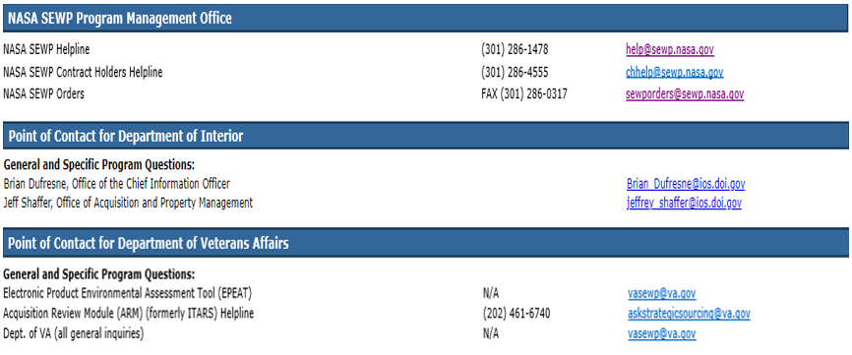
Government points of contact
NASA SEWP Program Management Office
Point of Contact for Department of Interior
Point of Contact for Department of Veterans Affairs

Slide 6
Agency Resources
SEWP contracts are currently used by all Federal Government Agencies. Agencies may have specific procurement procedures for using the contracts and SEWP can provide this guidance upon Agency request through the development of an Agency specific page, hosted on the SEWP website (see current Agency specific pages below).
Benefits of Agency specific pages include:
  Targeted information specific to your Agency's usage of the SEWP contracts
  Point of contact listing to direct Agency personnel for additional questions
  Central point of access for procurement related documentation
If your Agency would like an Agency specific page to provide specific instructions for utilizing SEWP, or any other procurement related information, please contact the SEWP Helpline at (301) 286-1478 or e-mail help@sewp.nasa.gov.
A current list of Agency specific pages, providing guidance/information to their users can be found below:
  United States Department of Defense (DoD) https://www.sewp.nasa.gov/agencies/DOD/index.shtml
  United States Department Interior (DOI)
    https://www.sewp.nasa.gov/agencies/DOI/index.shtml
  National Aeronautics and Space Administration (NASA)
    https://www.sewp.nasa.gov/agencies/NASA/index.shtml
  United States Department of Veterans Affairs (VA)
    https://www.sewp.nasa.gov/agencies/VA/index.shtml

Slide 7
About CDW-G

Slide 8
Trusted Information Technology Systems Integrator
CDW•G — Your Federal IT Solutions Integrator
We can help you procure, deploy and manage your IT while protecting your agency’s IT systems and purchases through our secure supply chain. CDW•G is a Trusted CSfC IT solutions integrator providing end-to-end support for hardware, software and services
Secure IT Supply Chain
There is a lot at risk when making IT purchases, which is why CDW•G provides a higher level of secure supply chain. As a holder of the ISO 28000 certification, CDW•G is a dependable provider of IT products and solutions. By purchasing with us, you’ll gain a new level of confidence in an uncertain world.
ISO Certifications
CDW•G has several ISO certifications, including:
ISO 9001 (PDF)
ISO 14001 (PDF)
ISO/IEC 20243 (PDF)
ISO 27001 (PDF)
ISO 28000 (PDF)

Slide 9

Why CDW-G?
DATA CENTER
WORKSPACE
NETWORKING
SECURITY
Cloud infrastructure
Data Management
Converged platforms
Software defined infrastructure
Desktop and Application deployment and management
Application delivery
Collaboration platforms
Cloud desktop
Enterprise networking
Campus and branch
Cloud in sight connectivity
Voice/ video services
Software defined networking
Assessment and discovery
Protection and defence infrastructure
Analysis services
Incident response
CDWG.com | 800.808.4239
CDW・G | Confidential

Slide 10



Our Business
Data center
Workspace
networking
Cloud infrastructure
Data Management
Converged platforms
Software defined infrastructure
          Desktop and Application deployment and management
    Application delivery
    Collaboration platforms
    Cloud desktop
    Enterprise networking
    Campus and branch
    Cloud in sight connectivity
    Voice/ video services
    Software defined networking
CDWG.com | 800.808.4239
CDW・G | Confidential

Slide 11




How We Work
REPLACE ICONS
Copy/paste from the icon library on last two slides
Assess
Services include:
IT Strategy Reviews
Assessments and System
Health Checks
Vendor Comparisons
Design
Services include:
IT Strategy Development
Envisioning Sessions (“Art of the Possible”)
System/Architectural Design
Deployment Planning
Proof of Concepts (leveraging demo labs or customer infrastructure)
Manage
Services include:
Warranty and Maintenance Agreements/Services
Managed Services (For On-Prem, Private Cloud, and Public Cloud Infrastructure
Help Desk
Centralized Billing
Deploy
Services include:
Product Acquisition Services (hardware, software/volume licensing, as-a-Service (XaaS), E-Procurement, Financing/Leasing)
Pre-shipment Configuration
Pilot and Production Implementation (including Migration and Integration)
CDWG.com | 800.808.4239
CDW・G | Confidential

